Slide 1

Using a Local Language Model together with
Retrieval-Augmented Generation (RAG) for answering
questions on custom data
By Alexander Pintsuk

Slide 2

Table of contents
Problem Statement
Introduction
Implementation
Demo
Evaluation
Summary
Literature

Slide 3
Problem statement
Language Models do not have all knowledge
Letting LM's learn new facts is computationally expensive and they even hallucinate
Offloading to the cloud raises Privacy concerns
LM's struggle with more complex tasks
Solution:
Fully locally Agent, with the ability to retrieve information and reason from it

Slide 4
2. Introduction

Slide 5
Introduction – Prompt techniques
Prompt:
Classify the text into neutral, negative or positive. Text: I think the vacation is okay.
Sentiment:
Response:
Neutral
Zero-shot prompting
Notes:
CoT prompts guide the model to break down a complex question into manageable steps.

Slide 6
Introduction – Prompt techniques
Prompt:
Classify the text into neutral, negative or positive. Text: I think the vacation is okay.
Sentiment:
Output:
Neutral
Prompt:
This is awesome! // Negative
This is bad! // Positive
What a horrible show! //
Response:
Negative
Zero-shot prompting
Few-shot
Notes:
CoT prompts guide the model to break down a complex question into manageable steps.

Slide 7
Introduction – Prompt techniques
Prompt:
Classify the text into neutral, negative or positive. Text: I think the vacation is okay.
Sentiment:
Output:
Neutral
Prompt:
This is awesome! // Negative
This is bad! // Positive
What a horrible show! //
Output:
Negative
Zero-shot prompting
Few-shot
CoT - Chain-of-Thought [1]
Prompt:
John has 10 apples. He gives away 4 and then receives 5 more. How many apples does he have?
Reasoning: John starts with 10 apples.
He gives away 4, so 10 - 4 = 6.
He then receives 5 more apples, so 6 + 5 = 11. Final Answer: 11
John has 9 apples. He gives away 4 and then receives 5 more. How many apples does he have?
Response:
….
Notes:
CoT prompts guide the model to break down a complex question into manageable steps.

Slide 8
Introduction – Prompt techniques
Prompt:
Classify the text into neutral, negative or positive. Text: I think the vacation is okay.
Sentiment:
Output:
Neutral
Prompt:
This is awesome! // Negative
This is bad! // Positive
What a horrible show! //
Output:
Negative
Zero-shot prompting
Few-shot
CoT - Chain-of-Thought [1]
ReAct – Reasoning and Act [2]
Prompt:
John has 10 apples. He gives away 4 and then receives 5 more. How many apples does he have?
Reasoning: John starts with 10 apples.
He gives away 4, so 10 - 4 = 6.
He then receives 5 more apples, so 6 + 5 = 11. Final Answer: 11
Output:
John has 9 apples. He gives away 4 and then receives 5 more. How many apples does he have?
Prompt:
Answer the following questions as best you can. You have access to the following tools: {tools} Use the following format: Question: the input question you must answer Thought: you should always think about what to do Action: the action to take, should be one of [{tool_names}] Action Input: the input to the action Observation: the result of the action ... (this Thought/Action/Action Input/Observation can repeat N times) Thought: I now know the final answer Final Answer: the final answer to the original input question
Notes:
CoT prompts guide the model to break down a complex question into manageable steps.

Slide 9








Introduction – Retrieval Augmented Generation - RAG
Process of combining information retrieval with language models [6]
Information retrieval includes local docs and the web
"Recommend me places to visit"
Retrieving
Knowledge
Language Model
Converted

Slide 10
Introduction – Retrieval Augmented Generation - RAG
Process of combining information retrieval with language models [6]
Information retrieval includes local docs and the web
"Recommend me places to visit"
Finding chunks
Retrieving
Knowledge
Vectordb
Chunking
Language Model
Converted

Slide 11

Chunking
"Recommend me places to visit"
Finding chunks
Retrieving
Knowledge
Vectordb
Chunking
Language Model
Converted

Slide 12

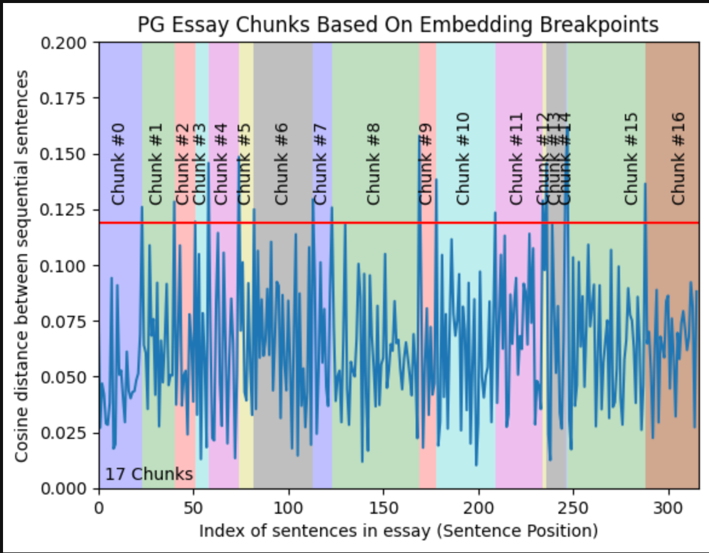
Chunking
Fixed-Size Character Splitting [10]
Recursive Chunking [10]
Semantic Chunking [10]
Overlap? Context?
Chunking
Figure 1. Semantic Chunking
Notes:
One common rule-based method is Fixed-Size Character Chunking, where text is divided into chunks of equal size based on a predetermined number of characters or words. This method can also allow overlap between chunks to maintain context between segments. It is simple, computationally efficient, and ideal for structured data where chunk size matters more than context, such as standardized surveys or genetic data analysis. Another rule-based approach, Recursive Chunking, splits the text until an optimal size and structure are achieved, prioritizing paragraph and line breaks to keep semantic meaning. It is slower but better for general, unstructured text, useful in applications like summarizing long documents or processing large collections of customer support records.

Slide 13
Embeddings
"Recommend me places to visit"
Finding chunks
Retrieving
Knowledge
Vectordb
Chunking
Language Model
Converted

Slide 14
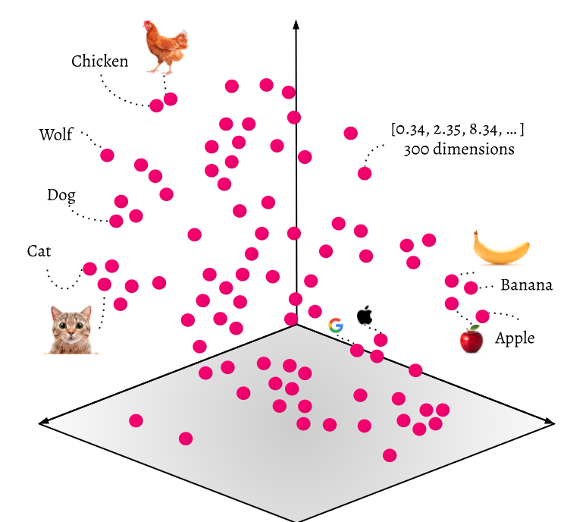
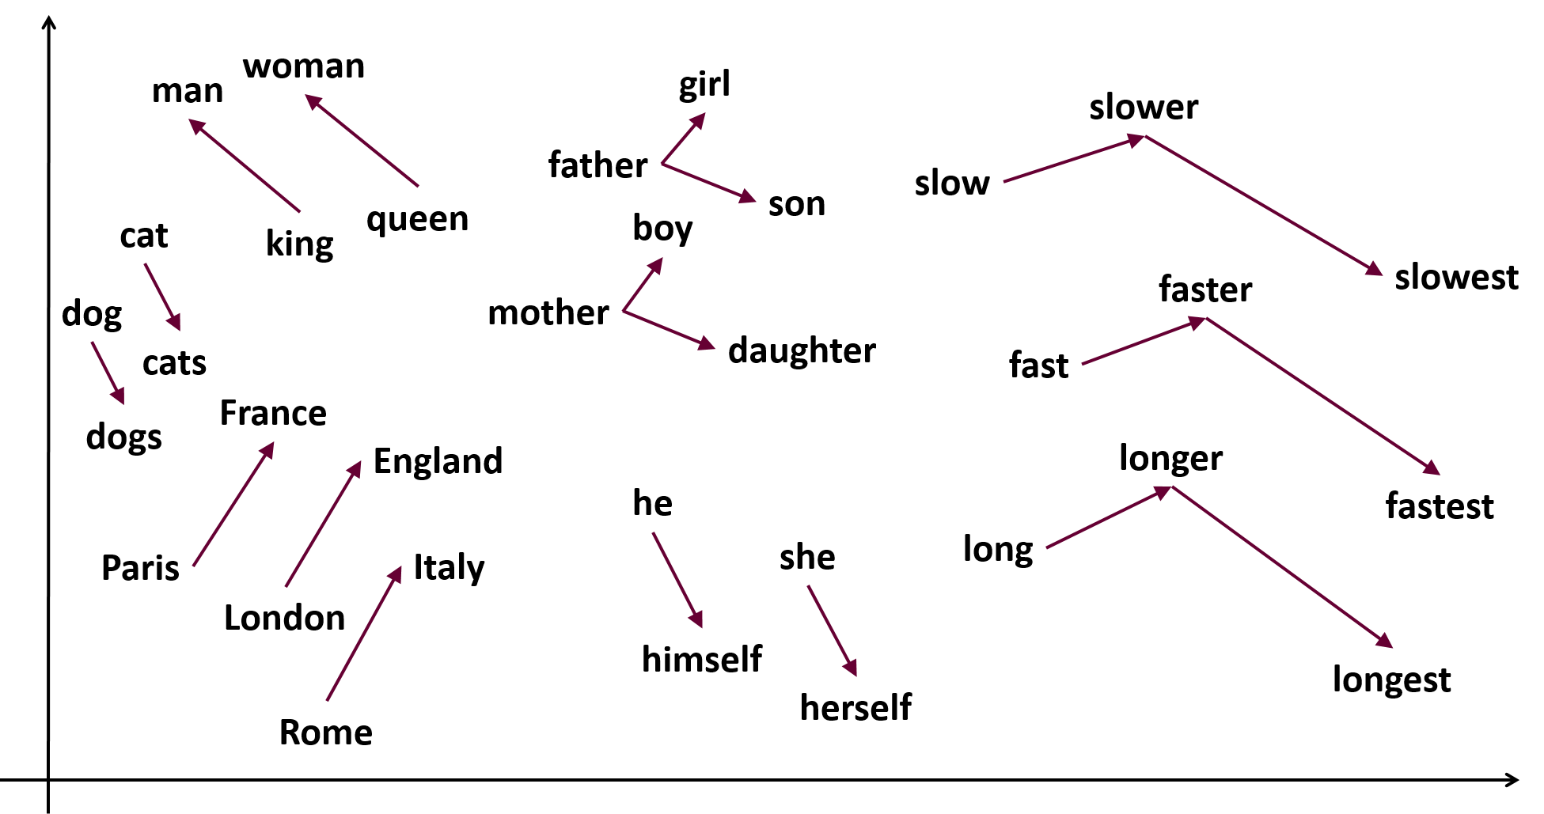
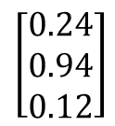
Embeddings
Represent data as a vector
Word Embeddings (Word2Vec) [7]
Sentence Embeddings [8]
Document Embeddings [9]
$$\left[\begin{aligned}0.24 \\ 0.94 \\ 0.12\end{aligned}\right]$$
Figure 2. Embedding space
King - Man + Women = Queen
Figure 3. Vector arithmetic
Notes:
In word embeddings each individual word is presented as a vector. Different methods are used to create these word embeddings. One popular method is called Word2Vec, which focuses on how words appear together in text.
In sentence embeddings, the complete sentence is represented as a vector. The goal is to capture the overall meaning of the sentence. Example Sentence-BERT
In document embeddings entire documents are represented as vectors. One example is Doc2Vec.

Slide 15


Vector Databases
Stores all embeddings
Leverages the power of semantics
Offers efficient search via indexing
Best of both worlds: Hybrid Search
$$\left[\begin{aligned}0.24 \\ 0.94 \\ 0.12\end{aligned}\right]$$
Figure 2. Embedding space
"Recommend me places to visit"
Search: "tourist attractions", as [ 0.94,0.43 , ..] and “places” keyword

Slide 16

Finding relevant chunks
"Recommend me places to visit"
Finding chunks
Retrieving
Knowledge
Vectordb
Chunking
Language Model
Converted

Slide 17
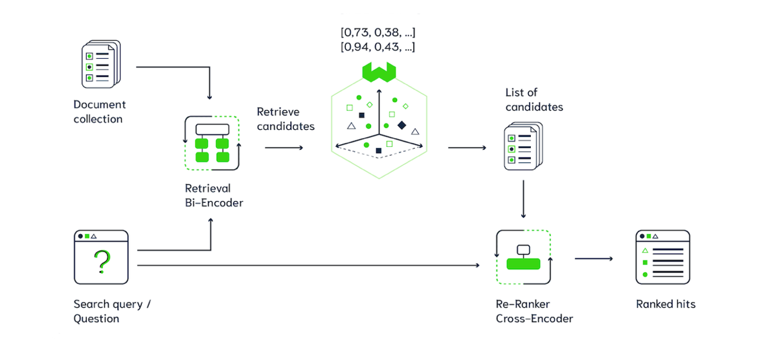
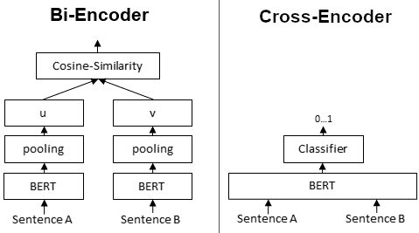
Finding relevant chunks
Keyword, vector search
Rerank all results
Give the best results as answer
Bi-Encoder [11]
Cross Encoder [12]
Similarity -> Symmetric Encoder
Figure 4. RAG pipeline
Figure 5. Encoders
Notes:
U – vector U
V- vector v
Pooling = After BERT Ecndoers one applies a pooling operation (average for example) to get a fixed-size vector representation

Slide 18
Language Model
"Recommend me places to visit"
Finding chunks
Retrieving
Knowledge
Vectordb
Chunking
Language Model
Converted

Slide 19
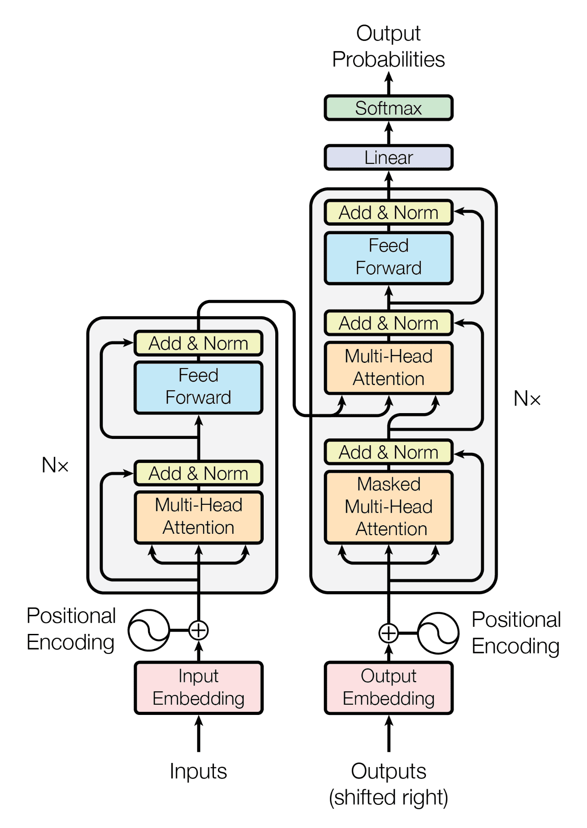
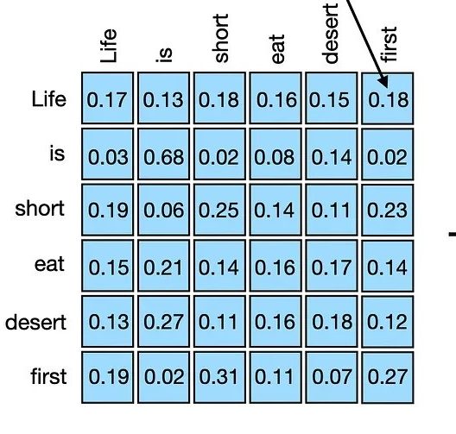
Language Model – Transformer Architecture
Decoder (GPT)
Uses "Self-attention": Weighting the significance of each part the input [3]
Quadratic complexity
Transformer: abstractive summarisation
Encoder: classification, Q&A, extractive summarisation [4]
Decoder: translation, generation [5]
Encoder (BERT)
Figure 6. Transformer Architecture
Notes:
Attention basically means to focus on the important pieces of information and to blend out the unimportant pieces.
Encoder: Processes the input and produces a fixed –size vector representation that is then fed into a classifier.
The encoder processes the input sequence and creates a contextualized representation (a vector or a sequence of vectors). This representation captures the meaning and information from the input.
The decoder takes the encoded representation and generates the output sequence. It does this step-by-step, often attending to different parts of the encoded representation at each step.

Slide 20
3. Implementation

Slide 21

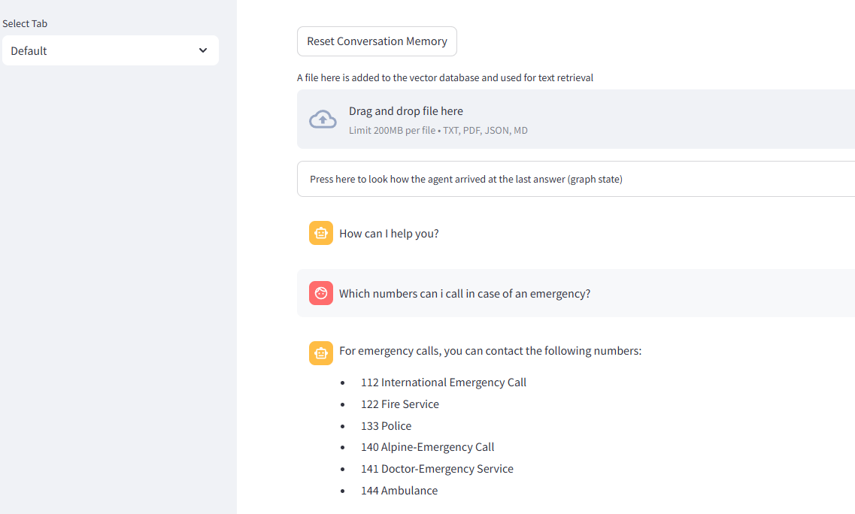
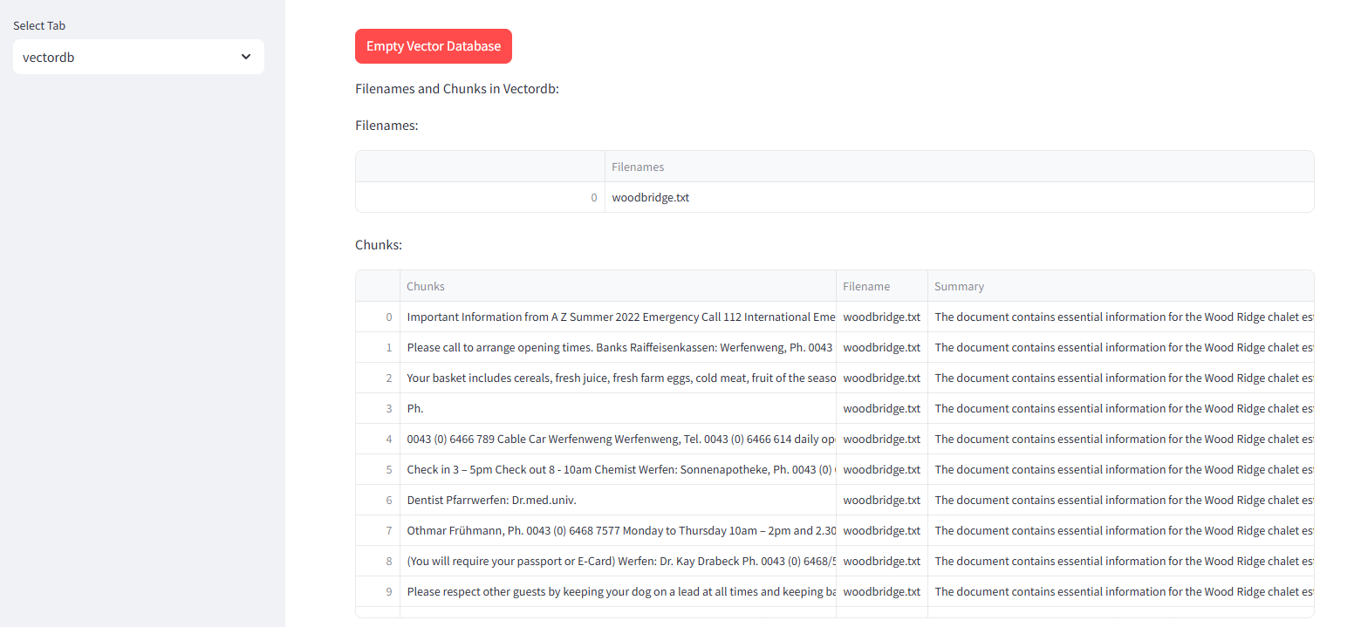
Implementation - Application Features
Chat in a chat window (Foreign languages allowed)
Upload Documents (english only)
Conversation Memory
"Debug view"
Agent state
Vector Database contents
Settings
Figure 3. Application View

Slide 22




Implementation - Application components
Web app
Database, Tools, Reranker ...
Agent
Web app
Database, Tools, Reranker ...
Agent

Slide 23
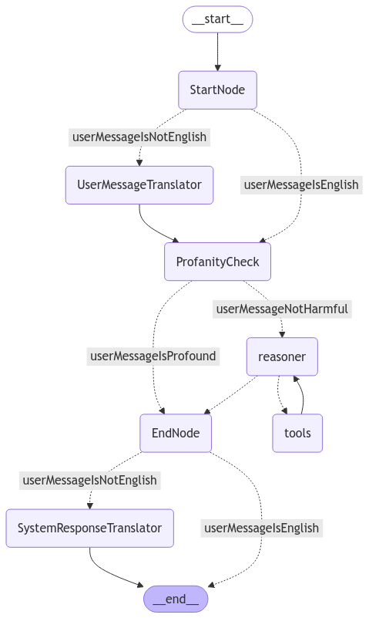
Agent flow
Input: Conversation
Translate user message (optional)
Check for profanity (toggle)
Call tools (optional)
Translate back (optional)
Properties
Uses "global" state to access/modify variables
Figure 3. Agent graph

Slide 24
Agent flow
Input: Conversation
Translate user message (optional)
Check for profanity (toggle)
Call tools (optional)
Translate back (optional)
Properties
Uses "global" state to access/modify variables
Figure 3. Agent graph

Slide 25



Agent components
Tools
Docsearch
Vector database
Tools
Websearch
Math
Language Models

Slide 26


Specifications
Reasoning Model: Llama3.1:8b
Translation Model: Aya:8b
Document Embedding Model: BAAI/bge-small-en-v1.5
Semantic Chunker Model: BAAI/bge-small-en-v1.5
Reranker Model: ms-marco-MiniLM-L-12-v2
Language Detector: papluca/xlm-roberta-base-language-detection
Sysprompt: "You are a helpful assistant with access to tools. You can search for relevant information using the provided tools and perform arithmetic calculations. For each question, determine if you can answer the question directly based on your general knowledge, or If necessary Use the `Search_in_document` tool to find the necessary information within the available documents. If you do not get an answer from the 'Search_in_document' tool Message or get an error, use the websearch tool, but the websearch tool should have lower priority.
Sysprompt: You are a professional translator. You must only translate the given human message into English. Even if the user writes a question, you have to translate the question to english and you are NOT allowed to respond to the question. Provide only the translated text without any additional information, comments, or explanations. Examples: Input: "Bonjour, comment ça va ?" Output: "Hello, how are you?" Input: "¿Dónde está la biblioteca?

Slide 27

4. Demo
https://localhost
Notes:
Code show:
2 major components:
Application & tests
Live Demo:
Upload woodrige (Background: Upload, chunk, embed, generate summary)
Show vectordb contents

Slide 28

5. Evaluation

Slide 29
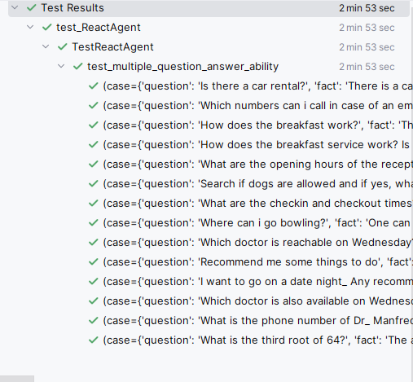
5. Evaluation
2 main evaluations
Simple Q&A
Non english Q&A
Method
Let a language model decide if the agent’s response is correct given a true fact
Logfile with
Questions
Facts
Snippets
Provided Contexts

Slide 30

6. Summary

Slide 31
6. Summary
Local Agents still have room for improvement
Local Language Models get more powerful over time
Tradeoff: Performance and Quality
Dependence on Libraries
Intransparent abstractions
Possible Strategies and Parameters

Slide 32
Literature
[1] Wei, J., Wang, X., Schuurmans, D., Bosma, M., Ichter, B., Xia,F., Chi, E., Le, Q., and Zhou, D. Chain-of-thought prompting elicits reasoning in large anguage models, 2023.
[2] Yao, S., Zhao, J., Yu, D., Du, N., Shafran, I., Narasimhan, K., and Cao, Y. React: Synergizing reasoning and acting in language models, 2023.
[3] Vaswani, A., Shazeer, N., Parmar, N., Uszkoreit, J., Jones, L., Gomez, A. N., Kaiser, L., and Polosukhin, I. Attention is all you need, 2023.
[4] Devlin, J., Chang, M.-W., Lee, K., and Toutanova, K. Bert: Pre-training of deep bidirectional transformers for language understanding, 2019.
[5] Radford, A., Narasimhan, K., Salimans, T., and Sutskever, I. Improving language understanding by generative pre-training.
[6] Lewis, P., Perez, E., Piktus, A., Petroni, F., Karpukhin, V., Goyal, N., and Kiela, D. Retrieval-augmented generation for knowledge-intensive nlp tasks. In Advances in Neural Information Processing Systems (2020), vol. 33, pp. 9459–9474.
[7] Kusner, M., Sun, Y., Kolkin, N., and Weinberger, K. From word embeddings to document distances. In Proceedings of the 32nd International Conference on Machine Learning (Lille, France, 07–09 Jul 2015), F. Bach and D. Blei, Eds., vol. 37 of Proceedings of Machine Learning Research, PMLR, pp. 957–966.
[8] Cer, D., Yang, Y., Kong, S., Hua, N., Limtiaco, N., John, R. S., Constant, N., Guajardo-Cespedes, M., Yuan, S., Tar, C., Sung, Y., Strope, B., and Kurzweil, R. Universal sentence encoder. CoRR abs/1803.11175 (2018).
[9] Sinoara, R. A., Camacho-Collados, J., Rossi, R. G., Navigli, R., and Rezende, S. O. Knowledge-enhanced document embeddings for text classification. Knowledge-Based Systems 163 (2019), 955–971.
[10] Kshirsagar, A. Enhancing rag performance through chunking and text splitting techniques. International Journal of Scientific Research in Computer Science, Engineering and Information Technology 10, 5 (2024), 151– 158.
[11] Reimers, N., and Gurevych, I. Sentence-bert: Sentence embeddings using siamese bert-networks, 2019.
[12] Tran, T. Q., Kang, M., and Kim, D. Rerankmatch: Semi-supervised learning with semantics-oriented similarity representation, 2021.

Slide 33
Figures
Figure 1: https://ai.gopubby.com/unleashing-the-power-of-semantic-chunking-a-journey-with-llamaindex-767e3499ca73
Figure 2: https://odsc.com/blog/getting-started-with-vector-based-search/
Figure 3: https://steemit.com/programming/@oddpotato/word2vec-introduction
Figure 4: https://weaviate.io/blog/cross-encoders-as-reranker
Figure 5: https://www.sbert.net/examples/applications/cross-encoder/README.html
Figure 6: [3]

Slide 34
Thank you for your Attention!

Slide 35
Facts
Dauer: 15 min. ~ 10 min präsentieren
1.Problem statement, Ziel d Arbeit
2. Grundlagen
Rag, prompt techniques: Cot, Zero shot, Transformer Architecture
3.Implementierung (high level)
4. demo (Code oder Applikation zuerst)
Livedemo wichtig (auch durch den Code herzeigen)
5. evaluierung
Testing erklären
6. Zusammenfassung, lessons learned
Letze seite literaturverzeichnis
Referenzen in der Präsentation mit Literaturverzeichnis.

Slide 36
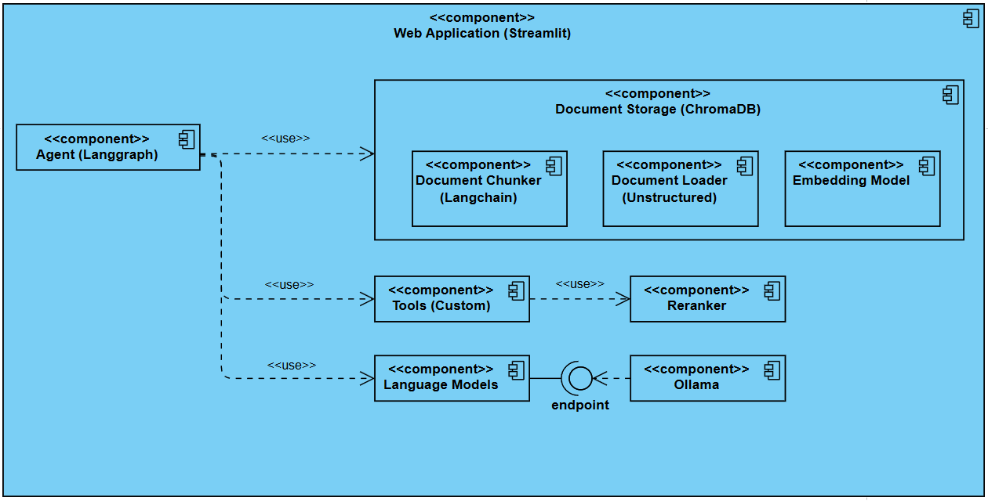


High level application components

Slide 37









High level application components

